Slide 1
Campaign Treasury 101- Non-Federal
September 10, 2022
Rebecca Klemin/Bryan Burch
Political Finance Solutions, Inc.

Slide 2
Getting Started
File Form 501 before raising or spending
Open a bank account
File Form 410 with Secretary of State
  Less than $2,000 Unqualified
  More than $2,000 Qualified
Within 10 days of raising or spending $2,000
Create a donate page
  eFundraising Connections, Anedot

Slide 3
Raising Money
Contribution Limits (per election):
  Check Local Jurisdiction for Specified Limits – AB 571
  CA State Limits & Districts with no local ordinance:
    $4,900 from Individual, Corporation, PAC
    $9,700 from Small Contributor Committee
    Unlimited from Political Party
Collect Name, Occupation/Employer, Physical Address (no PO Boxes) and FPPC Number (if a registered committee)
Any contribution over $100 must be itemized
LLC contributions must include Authorized Agent

Slide 4
Reports and Electronic Filing
File all campaign reports according to FPPC calendar
Electronic filing may be required; check local jurisdiction for e-filing requirements
Recommend purchasing electronic software for E-filing and donor record database (I.E. Netfile, IS Political, etc)
Original paper filing (if required) must have candidate and treasurer original signatures and is filed with the SOS/City Clerk
If a paper filer – original report plus a copy to SOS/City Clerk
Normally reports are due:
  July 31st (period covers 1/1-6/30)
  January 31st (period covers 7/1-12/31)
  Primary Pre-Election Reports (April & May)
  General Pre-Election Reports (September & October)
  24-hour reports of any contribution over $1,000 within 90 days of election

Slide 5
Disclaimers
All communications asking for money must include a disclaimer stating who paid for the piece
Similar size and font (no less than 6-point font in contrasting color)

Slide 6
Basics of a Form 460
Cover page
Summary page
Schedule A – Monetary Contributions Received
Schedule B – Loans Received
Schedule C – Non-monetary Contributions Received
Schedule D – Expenditures Supporting/Opposing Other Candidates
Schedule E – Payments Made
Schedule F – Accrued Expenses
Schedule G – Payments made by an Agent
Schedule H – Loans Made to Others
Schedule I – Miscellaneous Increases to Cash

Slide 7
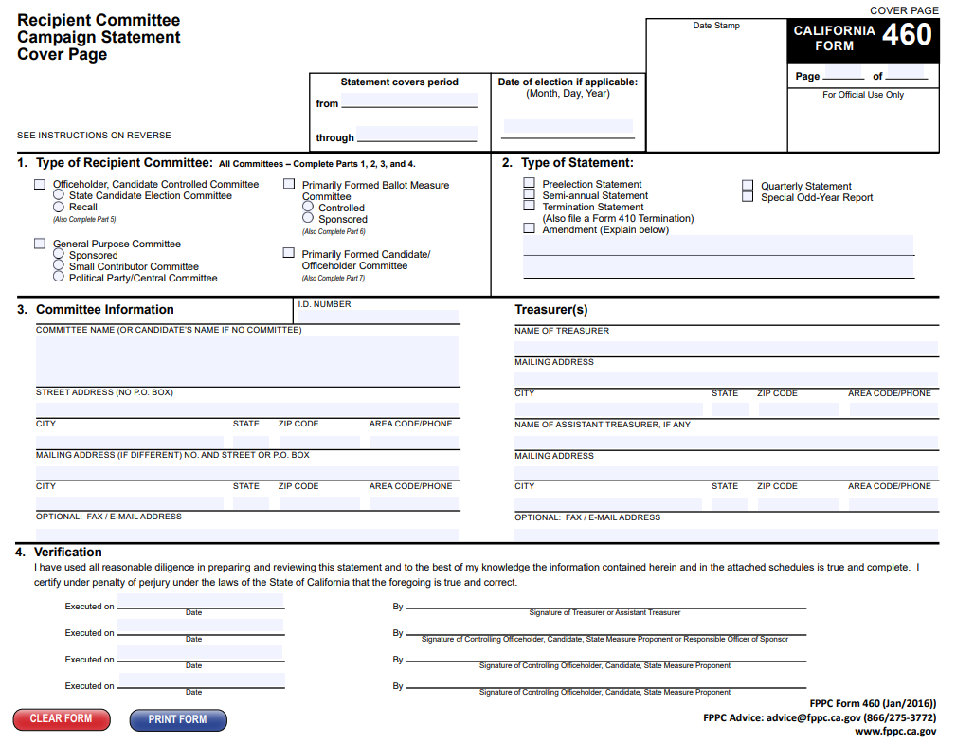
Cover Page
Includes committee information
Type of statement
Period statement covers
Signatures

Slide 8
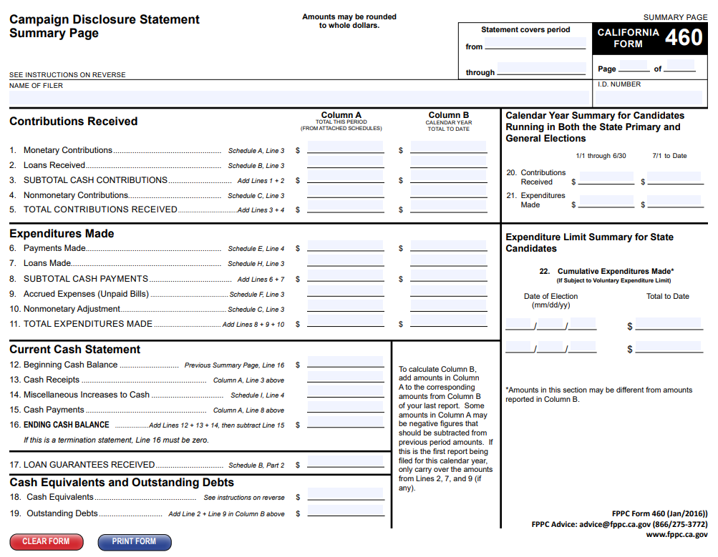
Summary Page
Contributions Received
Expenditures Made
Current Cash Statement
Outstanding Debt

Slide 9
Schedule A – Monetary Contributions Received
All itemized contributions from period
Contributor information
Date received
Cumulative Year-to-Date information
Amount of unitemized contributions

Slide 10
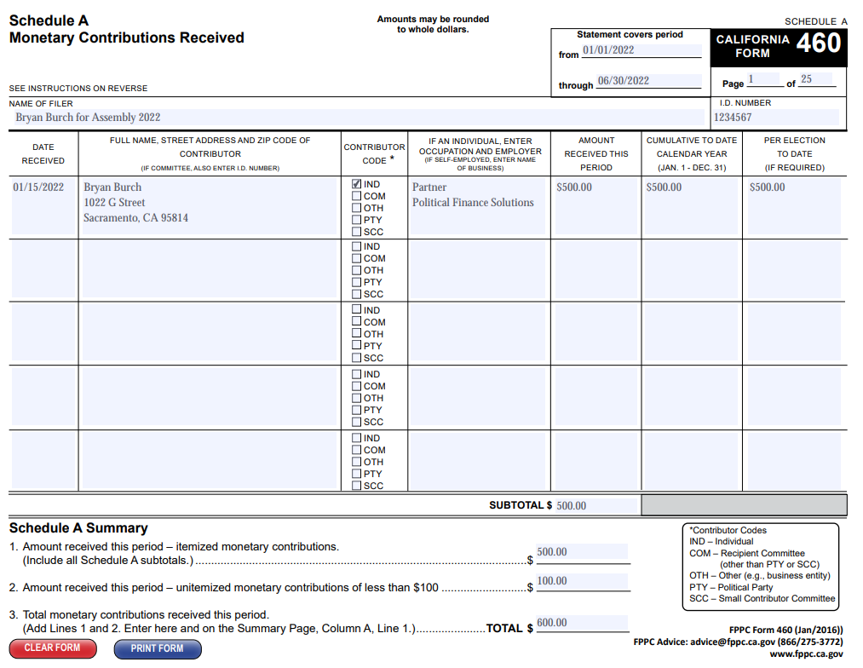

Slide 11
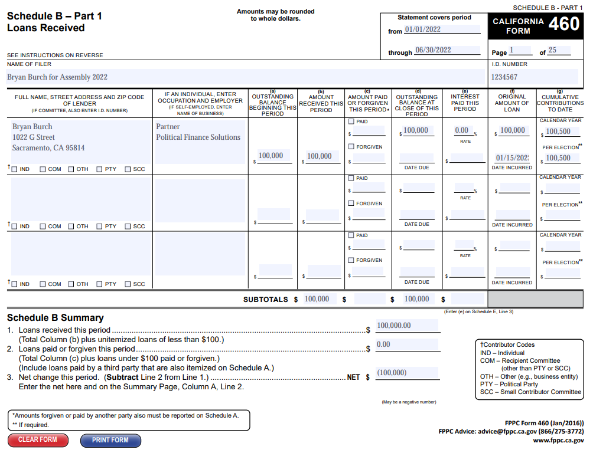
Schedule B – Loans Received
Lender’s information
Amount received
Amount paid in period
Amount outstanding
Interest rate on loan

Slide 12
Schedule C – Non-Monetary Contributions Received
In kinds treated exactly like monetary contributions
Fair Market Value of item
  Services provided at no charge
  Auction Items
  Donated Goods

Slide 13
Schedule D – Expenditures Supporting/Opposing Candidates or Measures
Date expenditure was made
Committee information, including district number or ballot measure
Support or Oppose

Slide 14
Schedule E – Payments Made
All itemized payments
Must have FPPC code or description of expense

Slide 15
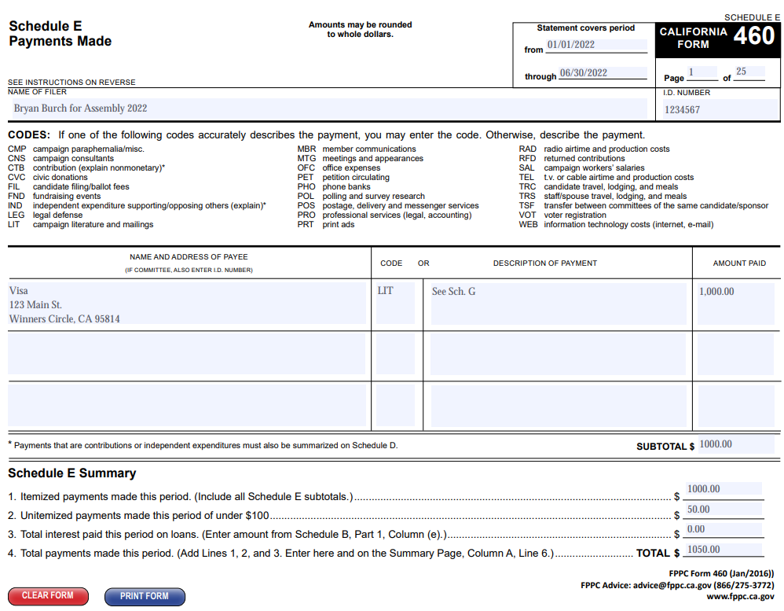

Slide 16
Schedule F – Accrued Expenses
Itemized unpaid bills at close of period
Itemized bills paid from previous period

Slide 17
Schedule G – Payments made by an Agent
Must provide subvendor information for any expense over $500 paid by a vendor
Must provide subvendor information for any credit card payments over $100
Includes reimbursements, campaign credit card payments, etc.
Example:
  Payment made by campaign to Visa of $1,000 reported on Schedule E
  Individual charges from statement reported on Schedule G

Slide 18
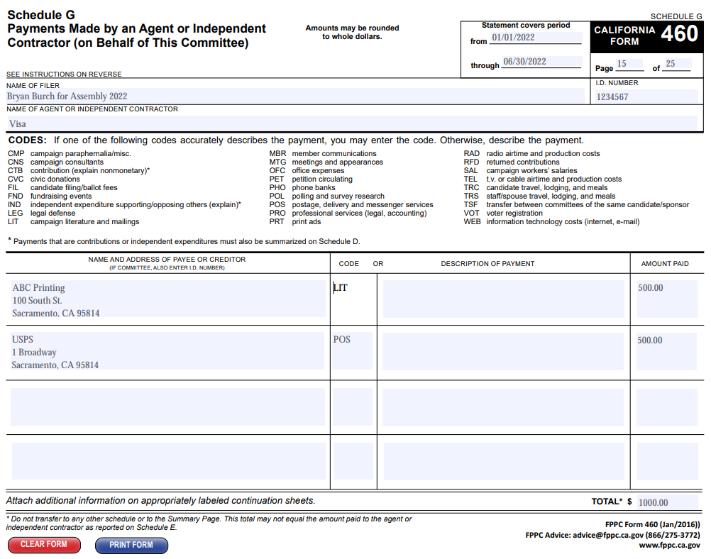

Slide 19
Schedule H – Loans made to Others
Any loans made to another committee

Slide 20
Schedule I – Misc. Increases to Cash
Cash received not defined as contributions:
  Interest earned
  Sale of campaign property
  Refunds
  Payment of Auction Items

Slide 21
Things To Be Aware of:
Cash
Spending Personal Funds
Charges on Your Credit Card
PO Boxes
Ignoring Your Donors
Paypal and Apple Pay
Thinking you can do this on your own

Slide 22
Please contact me with any questions!
Rebecca Klemin/Bryan Burch
Political Finance Solutions, Inc.
916.476.6926 www.politicalfinancesolutions.com

